Slide 1
EcoLink: Smart Environmental Monitoring System
Team: Ardubots
Presented By:
Lal Awnish Nath Sahdeo
Gaurang Jadoun Aryan Jaiswal Amogh Dixit

Slide 2
List Of Contents:
Introduction
Why this particular topic?
Methodologies, logic and components used
Description of the project
Result
Future scope (Feasible or Non Feasible)
References

Slide 3
Advantages of long range wireless networking for environmental monitoring
1
Remote Accessibility
2
Cost-Efficiency
Eliminates the need for extensive cabling infrastructure, reducing installation and maintenance costs.
Long-range wireless networking enables remote access to environmental data, allowing monitoring from distant locations.
3
Real-Time Monitoring
4
Scalability
Allows easy expansion of monitoring networks to cover larger geographic areas for comprehensive data collection.
Provides real-time data collection, analysis, and alerts, enhancing response time to environmental changes.

Slide 4


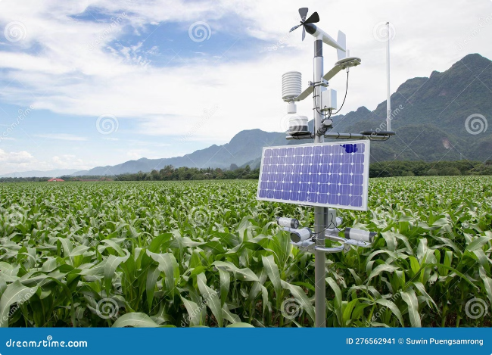
a
Sensor Integration and Data Collection
1
Sensor Deployment
Sensors are strategically placed in the environment to collect data.
2
Data Acquisition
Sensors collect data on environmental parameters and transmit it to gateways.
3
Data Aggregation
Gateways collect data from multiple sensors and aggregate it before transmitting it to the central system.

Slide 5




Types of sensors used in long range wireless environmental monitoring
Temperature Sensor
Air Quality Sensor
Water Quality Sensor
Sound Sensor
Measures noise levels. Crucial for wildlife conservation and noise pollution control.
Measures environmental temperature. Used in weather monitoring and climate studies.
Detects pollutants in the air. Vital for assessing air pollution and respiratory health.
Monitors water purity and pollution levels. Essential for safeguarding aquatic ecosystems.

Slide 6
Communication Protocols for Long Range Wireless Environmental Monitoring
LoRaWAN
NB-IoT
A low-power, wide-area network protocol for long-range communication in environmental sensors.
Narrowband IoT protocol for connecting devices over long distances with low power consumption.
Sigfox
Weightless
An LPWAN technology known for its long-range coverage and low energy consumption.
A wide-area wireless technology designed for long-range communication in IoT applications.

Slide 7
Challenges in implementing long range wireless environmental monitoring
Power Management
1
Balancing energy efficiency and continuous data transmission.
2
Interference
Overcoming signal disruptions in remote and densely populated areas.
Data Security
3
Protecting sensitive environmental data from potential breaches.
Scalability
4
Expanding networks while ensuring seamless connectivity and coverage.
Implementing long-range wireless environmental monitoring presents several challenges. Managing power effectively, overcoming signal interference, ensuring data security, and maintaining network scalability are critical factors to address for successful deployment.

Slide 8
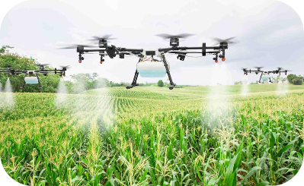
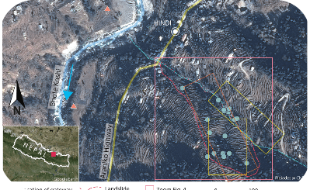
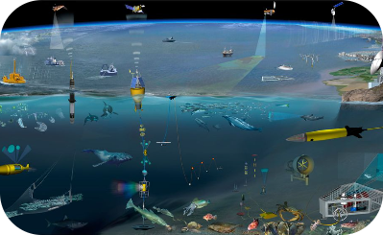
Case studies of successful long range wireless environmental monitoring projects
Agriculture Monitoring
Wildlife Conservation
Water Quality Management
A wireless sensor network in agriculture monitoring soil moisture, temperature, and humidity for optimized irrigation.
Successful use of wireless environmental monitoring to track endangered species and protect their habitats.
Monitoring and analyzing water quality parameters in lakes, rivers, and coastal areas for conservation purposes.

Slide 9
Comparison of Long Range Wireless Networking with Other Environmental Monitoring Methods
Long Range Wireless Networking
Other Monitoring Methods
Enables real-time data collection from remote or difficult-to-access locations.
May require manual data collection, which can be time-consuming and labor-intensive.
Reduces the need for physical infrastructure, leading to cost savings and increased scalability.
Often limited by the range of wired or local wireless networks, hindering data collection from remote areas.
Provides flexibility in adjusting the sensor network based on changing environmental conditions.
Less adaptable to evolving environmental conditions and may require frequent maintenance.

Slide 10




Future of long range wireless environmental monitoring
Advanced Sensor Technology
1
Enhanced sensors for precise data collection
Machine Learning Integration
2
AI-driven analytics for actionable insights
Real-time Data Visualization
3
Interactive dashboards for immediate analysis
Enhanced Security Measures
4
Robust encryption and protection protocols

Slide 11
Key considerations when selecting long range wireless networking for environmental monitoring
Range
Consider the required distance the data needs to travel.
Battery Life
Evaluate the power consumption and lifespan of sensor batteries.
Data Rate
Assess the frequency and volume of data transmission.
Interference
Understand potential sources of radio frequency interference.
Scalability
Plan for the ability to expand the network as needed.

Slide 12


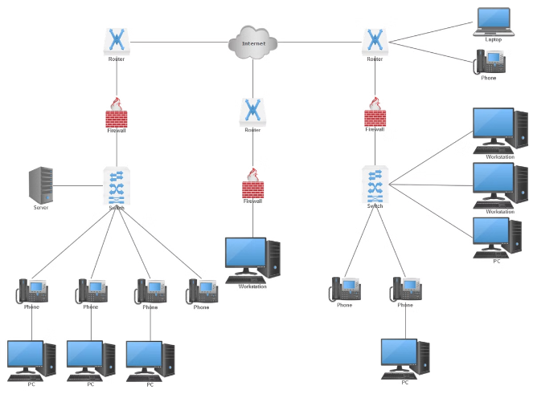



Block Diagrams
Sensors
Collect data from the environment
Network
Connects sensors, gateways, and the central system
Cloud Platform
Stores and processes data, providing insights and analytics
Central System
Manages the network and displays real-time data

Slide 13
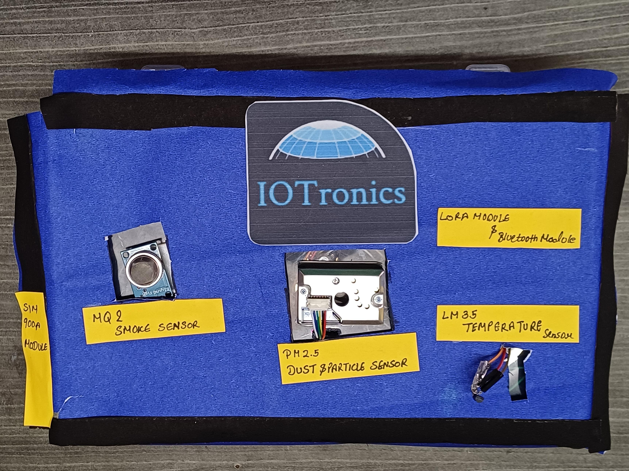
Future advancements will drive efficiency and accuracy in environmental monitoring.

Slide 14
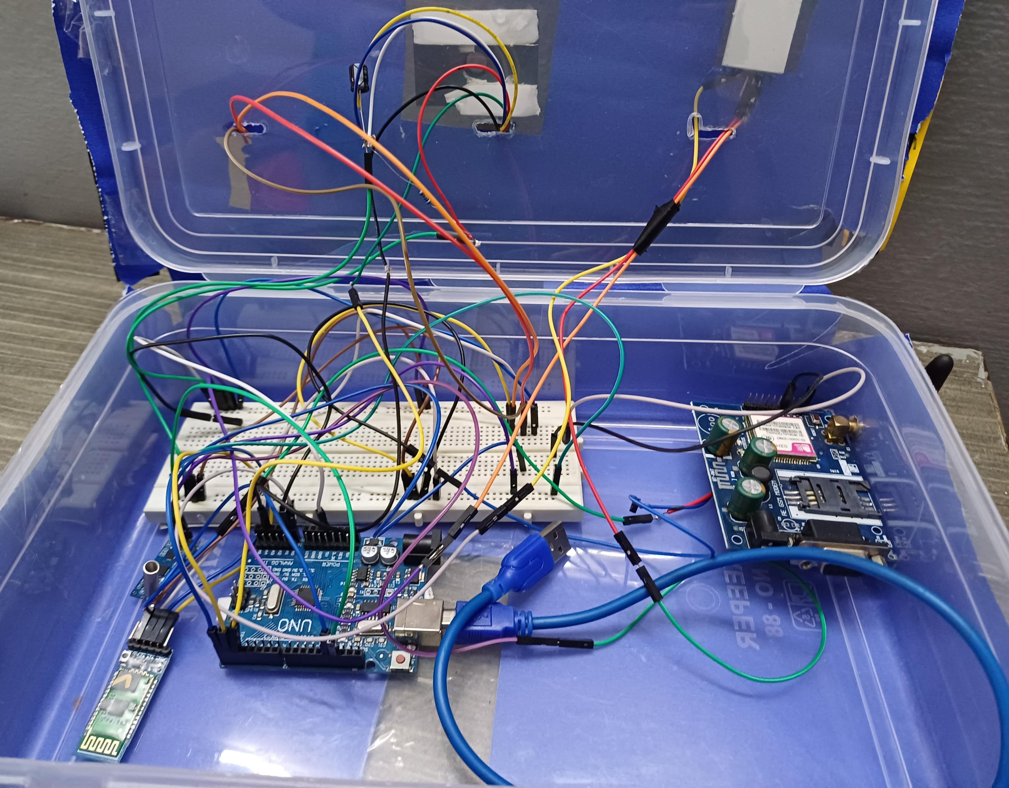
Future advancements will drive efficiency and accuracy in environmental monitoring.

Slide 15


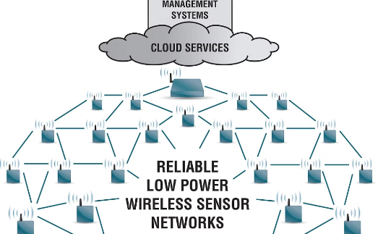
Future Scope
Drones for Data Collection
Artificial Intelligence for Data Analysis
Advanced Networking Technologies
Drones equipped with sensors can provide aerial data for environmental monitoring.
AI algorithms can analyze vast datasets to identify patterns and trends, providing deeper insights into environmental changes.
Emerging technologies like 5G and satellite internet will enhance connectivity and data transmission.

Slide 16


Reference Papers
Further reading on long range wireless networking for environmental monitoring.
Reference 1: Long-Range Wireless Networks for Environmental Monitoring: A Review
Reference 2: Long-Range Wireless Sensor Networks for Precision Agriculture: A Comprehensive Review

Slide 17


Slide 18
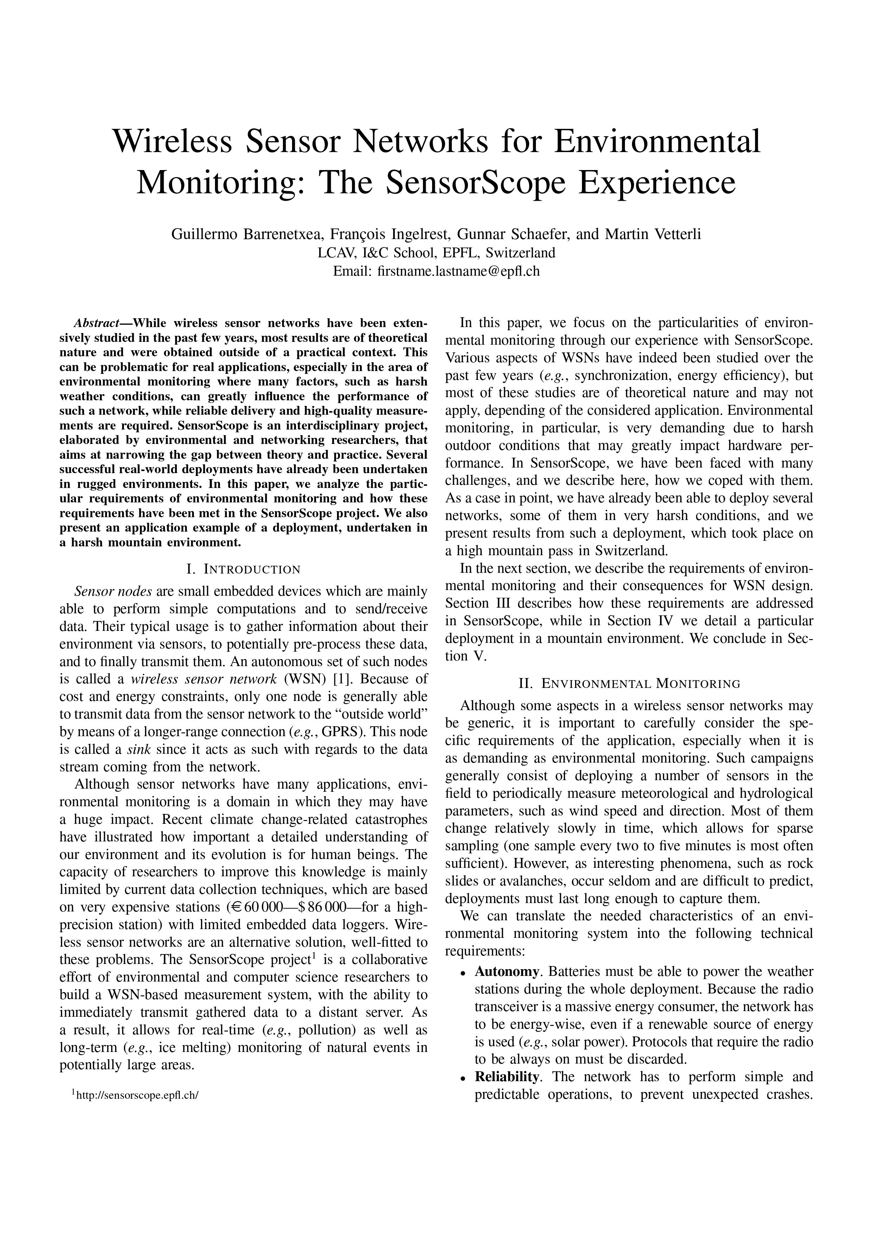

Slide 19
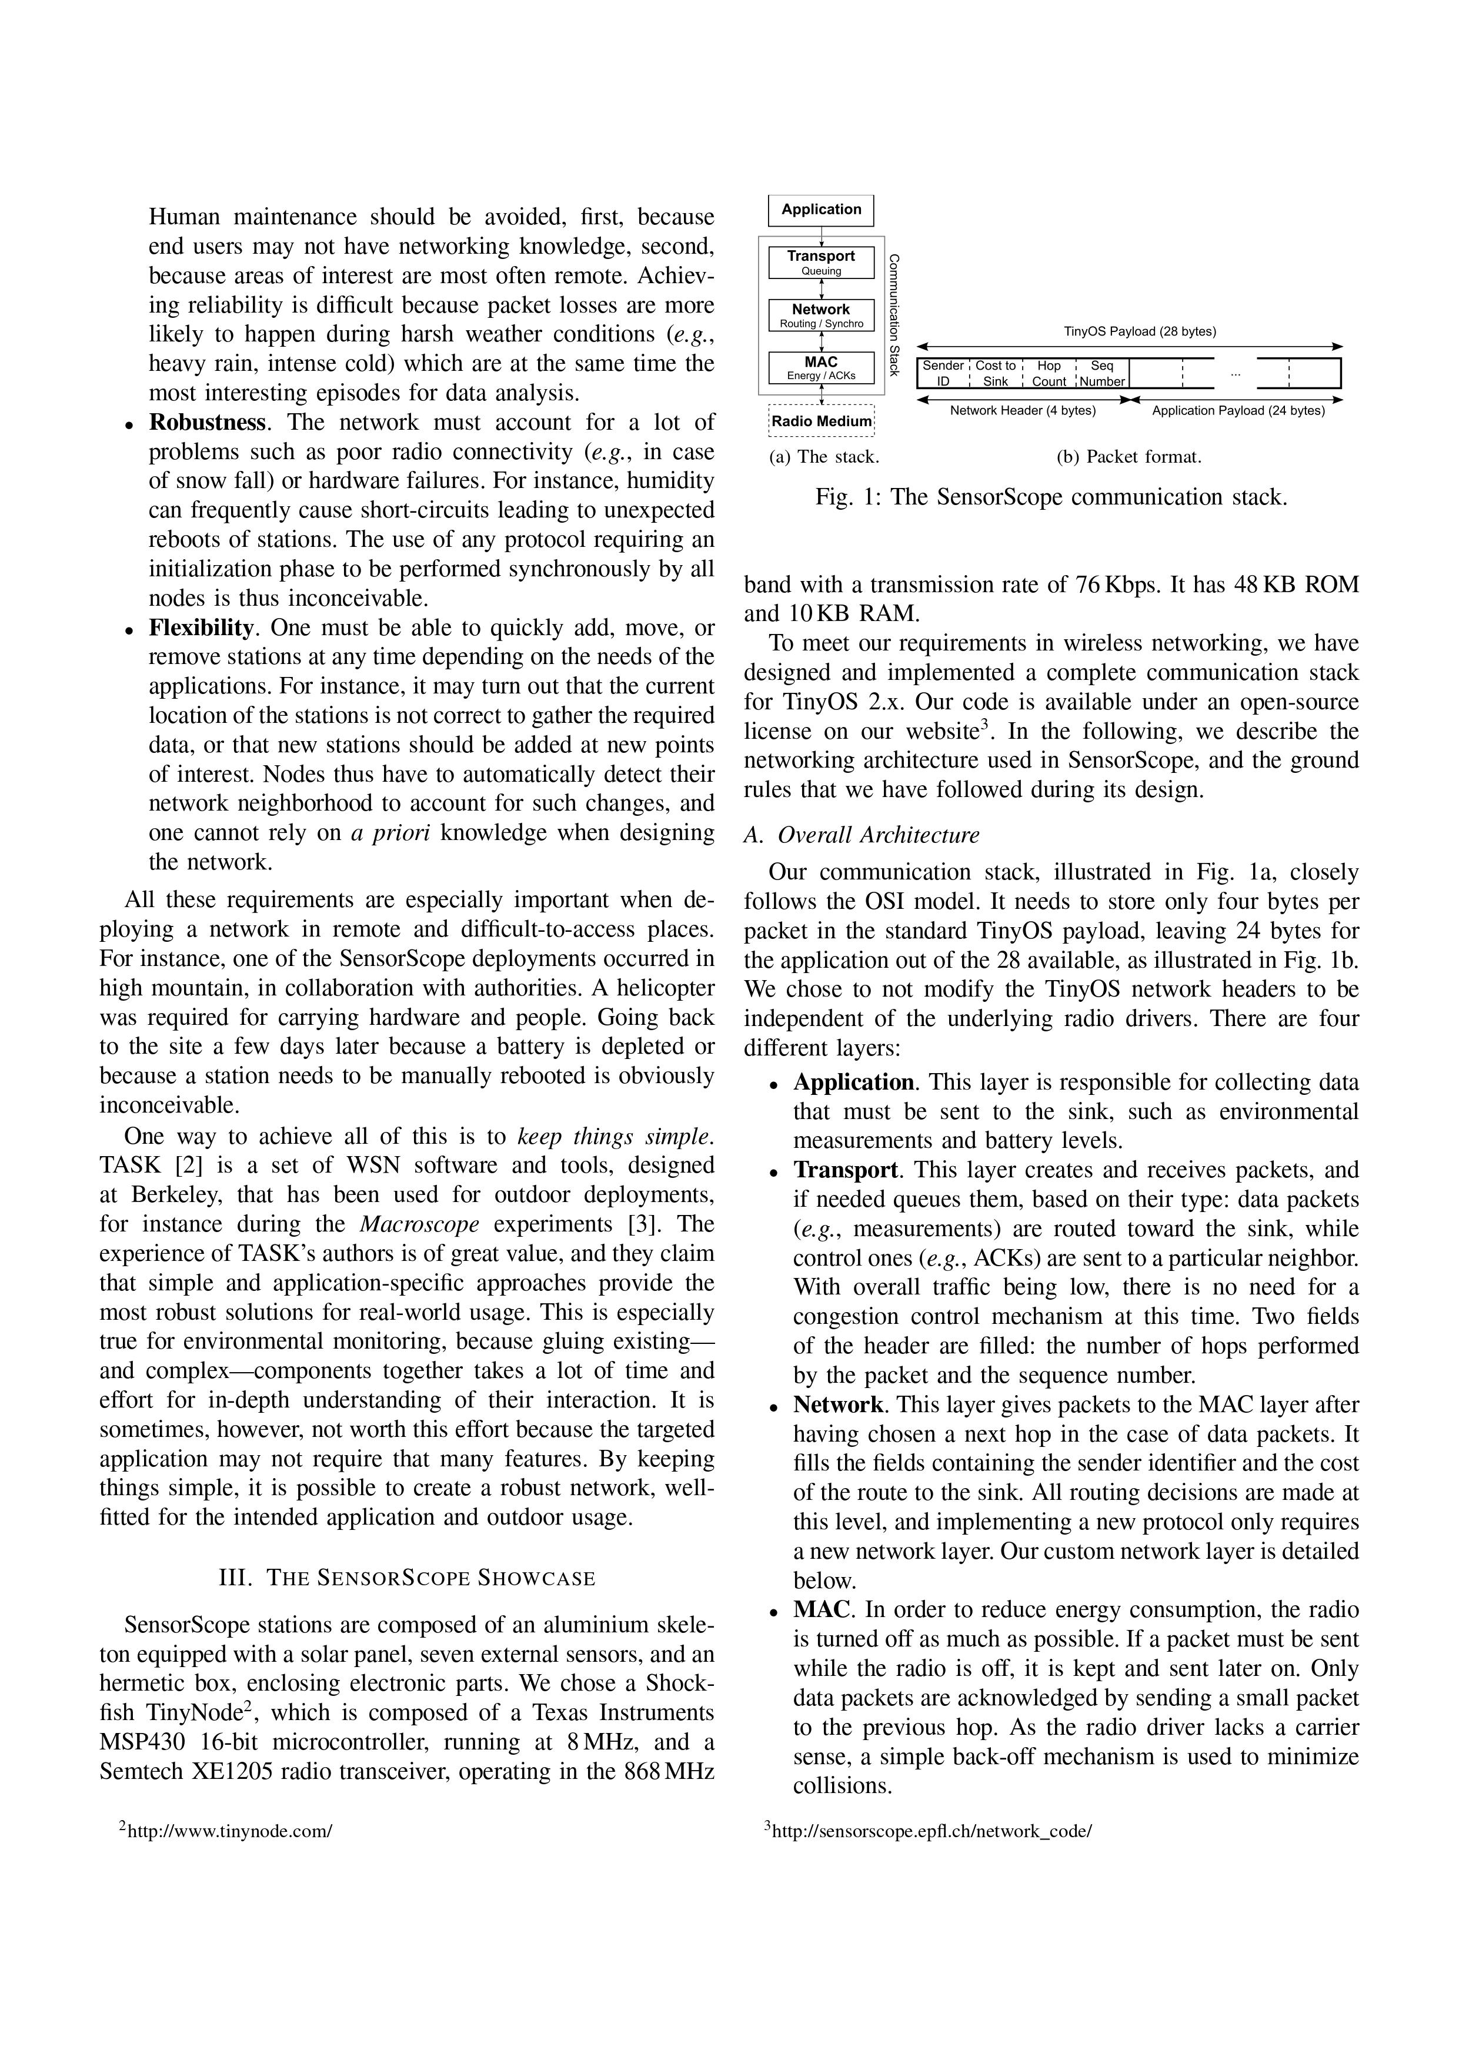

Slide 20
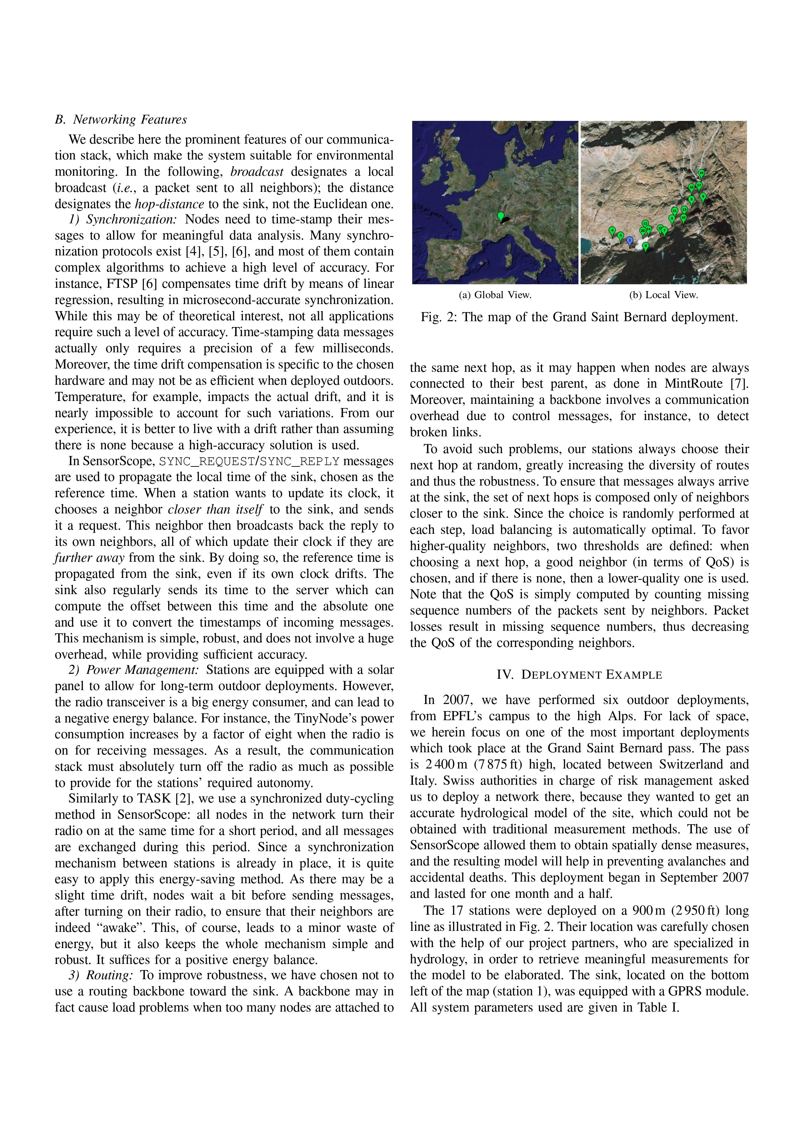

Slide 21
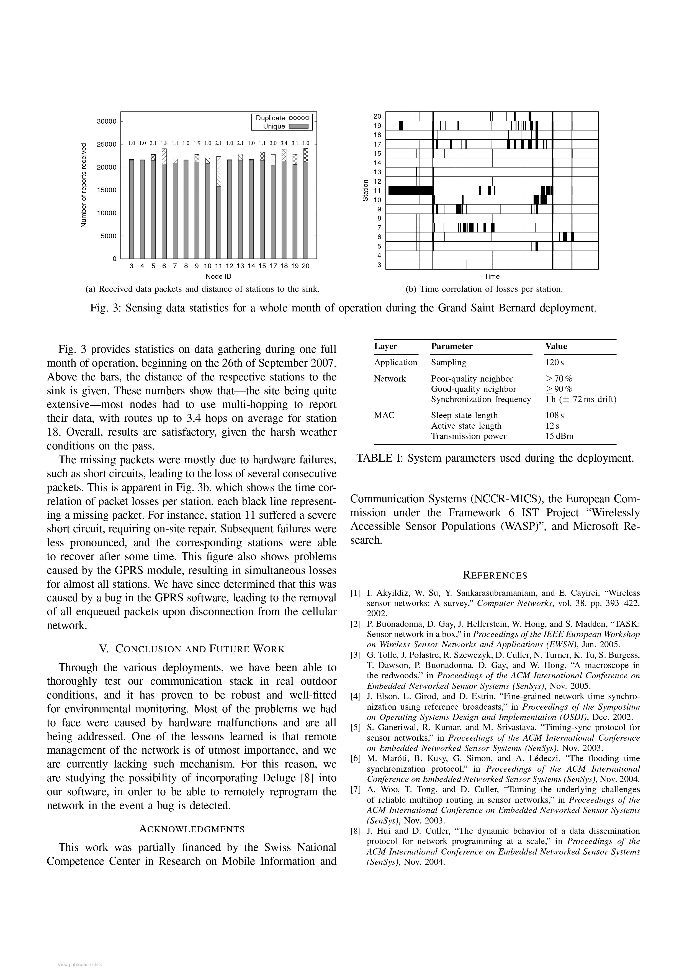

Slide 22
Thank You

